Slide 1
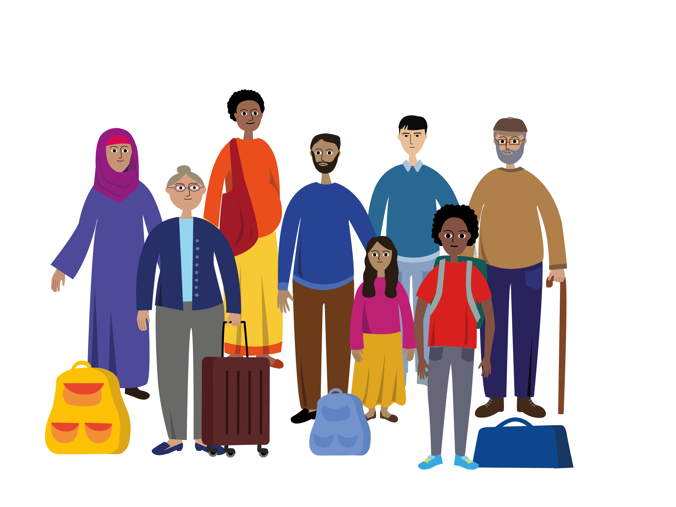
WHAT YOU NEED TO KNOW ABOUT the first steps of the asylum procedure

Slide 2
You have arrived IN the european union
You are safe here.
You can apply for international protection, which is also known as asylum.

Slide 3
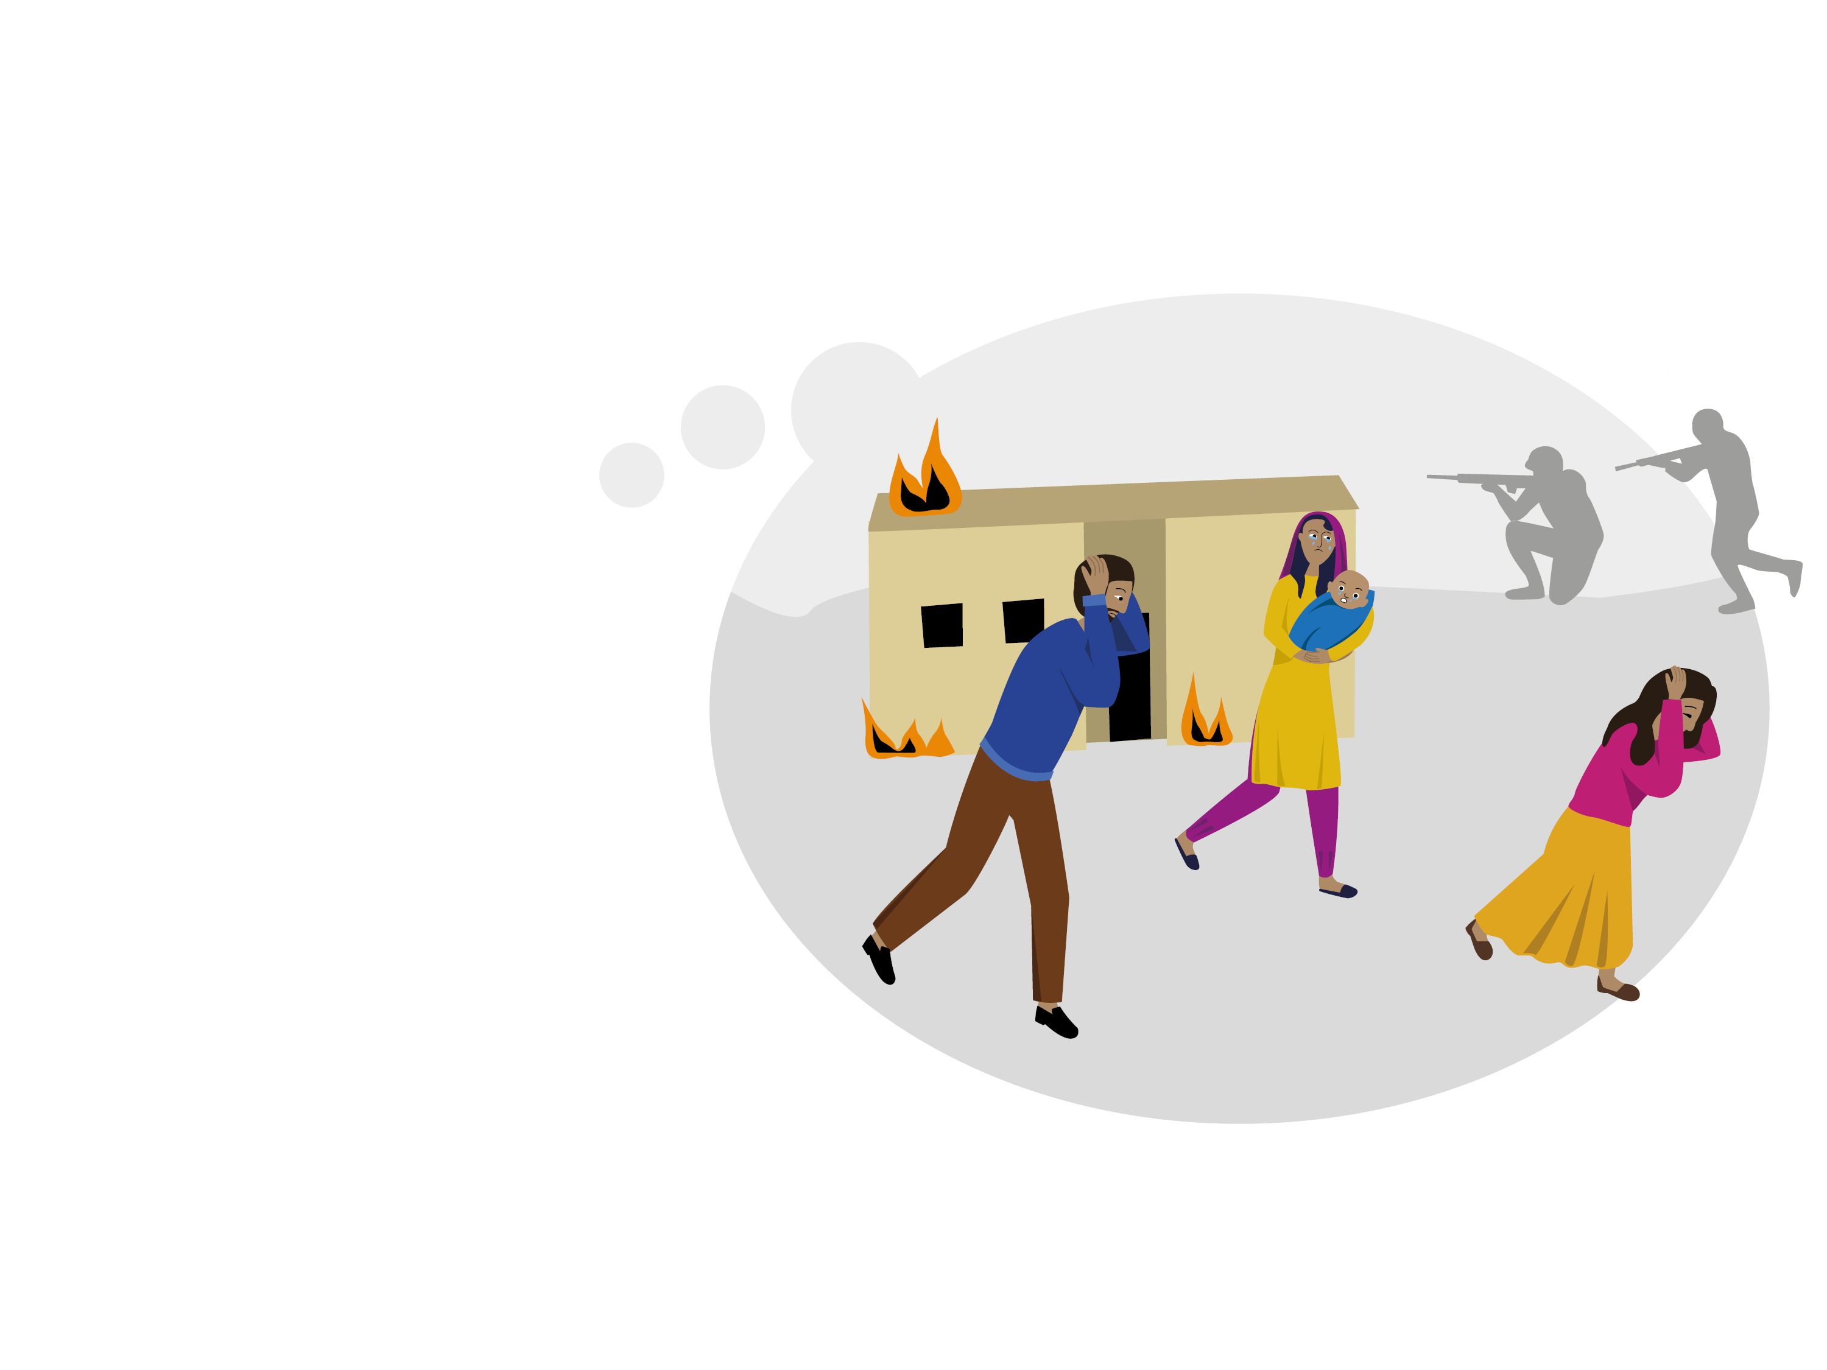
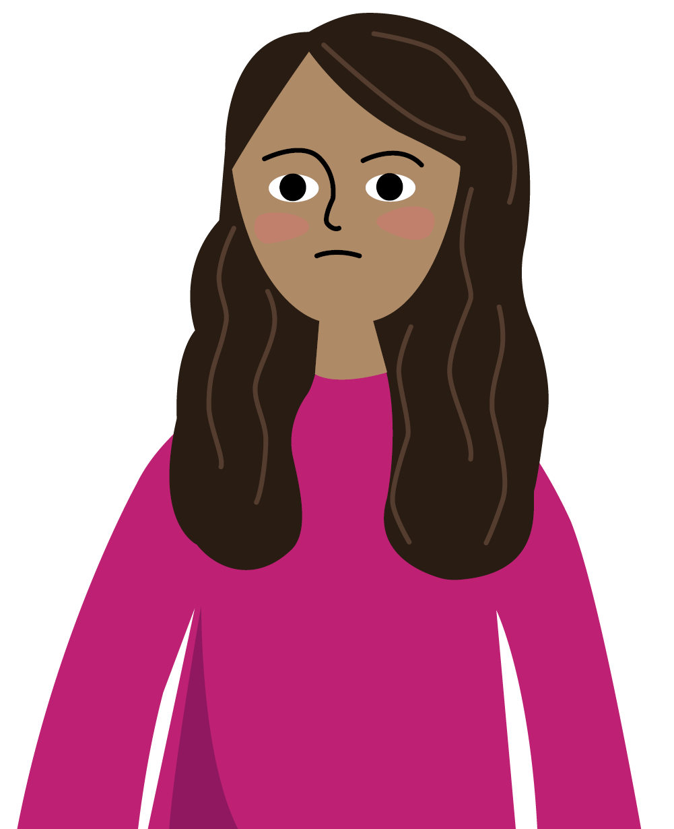
You may need international protection
if you cannot go back to your country
because you are afraid for your life

Slide 4
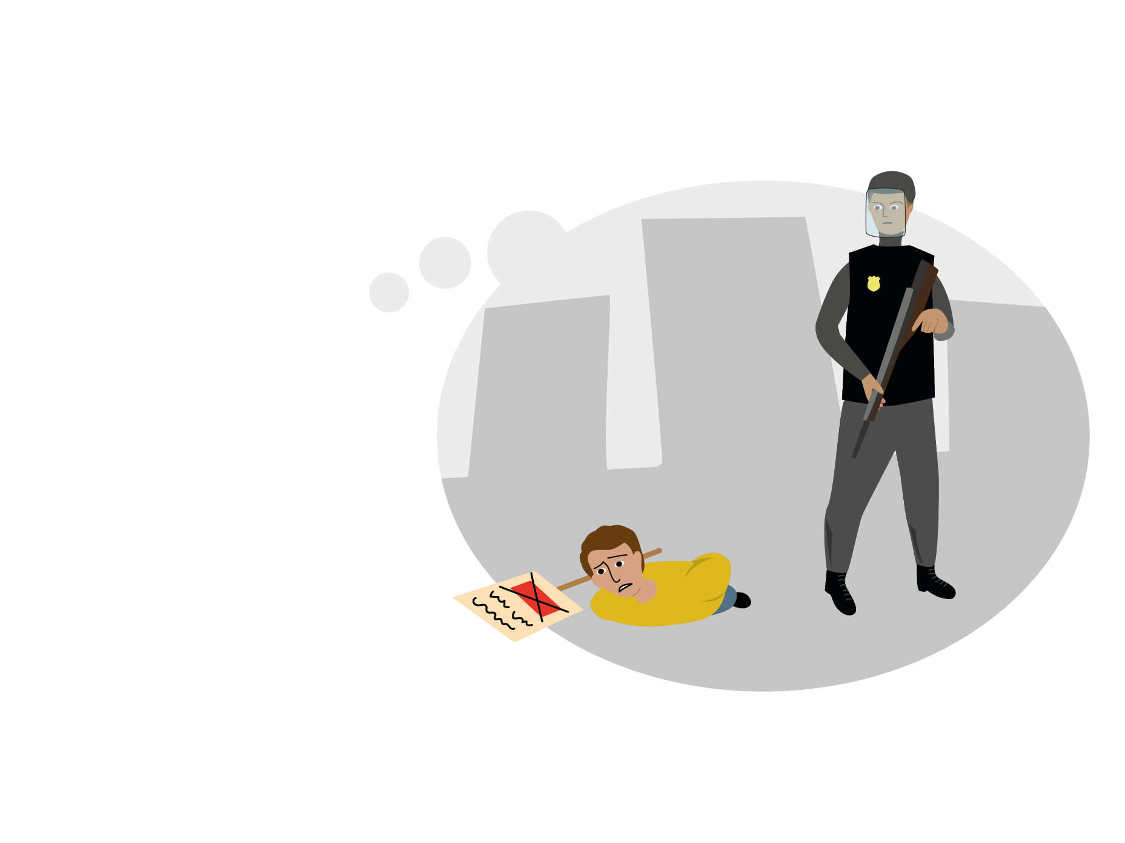
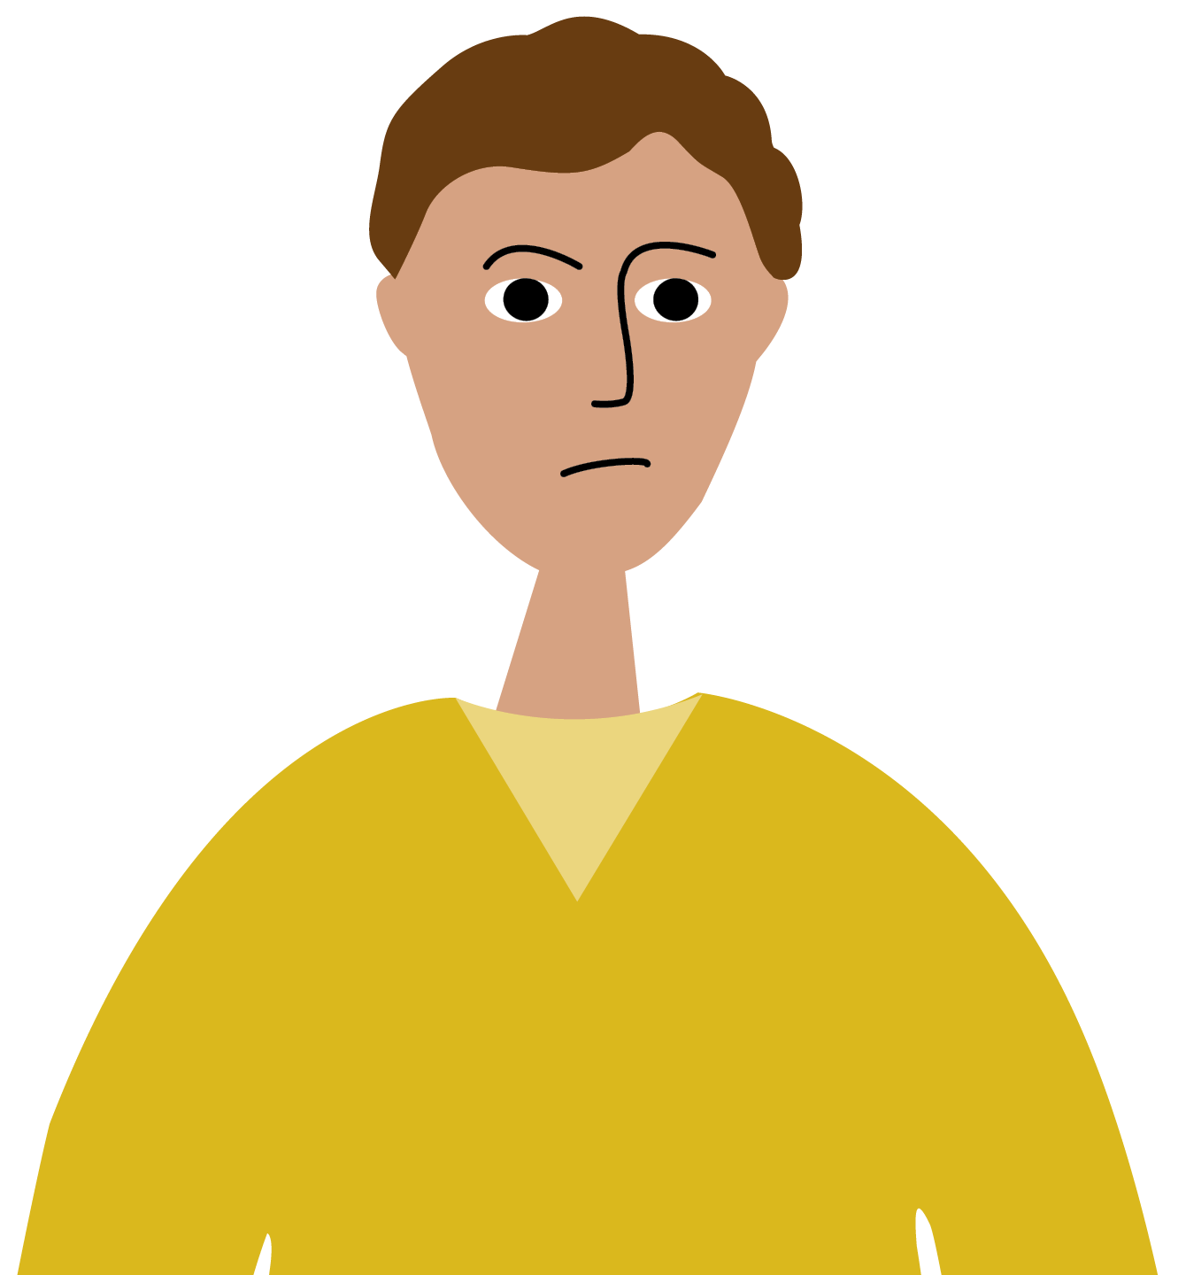
You may need international protection
if you cannot go back to your country
because your freedom will be threatened

Slide 5
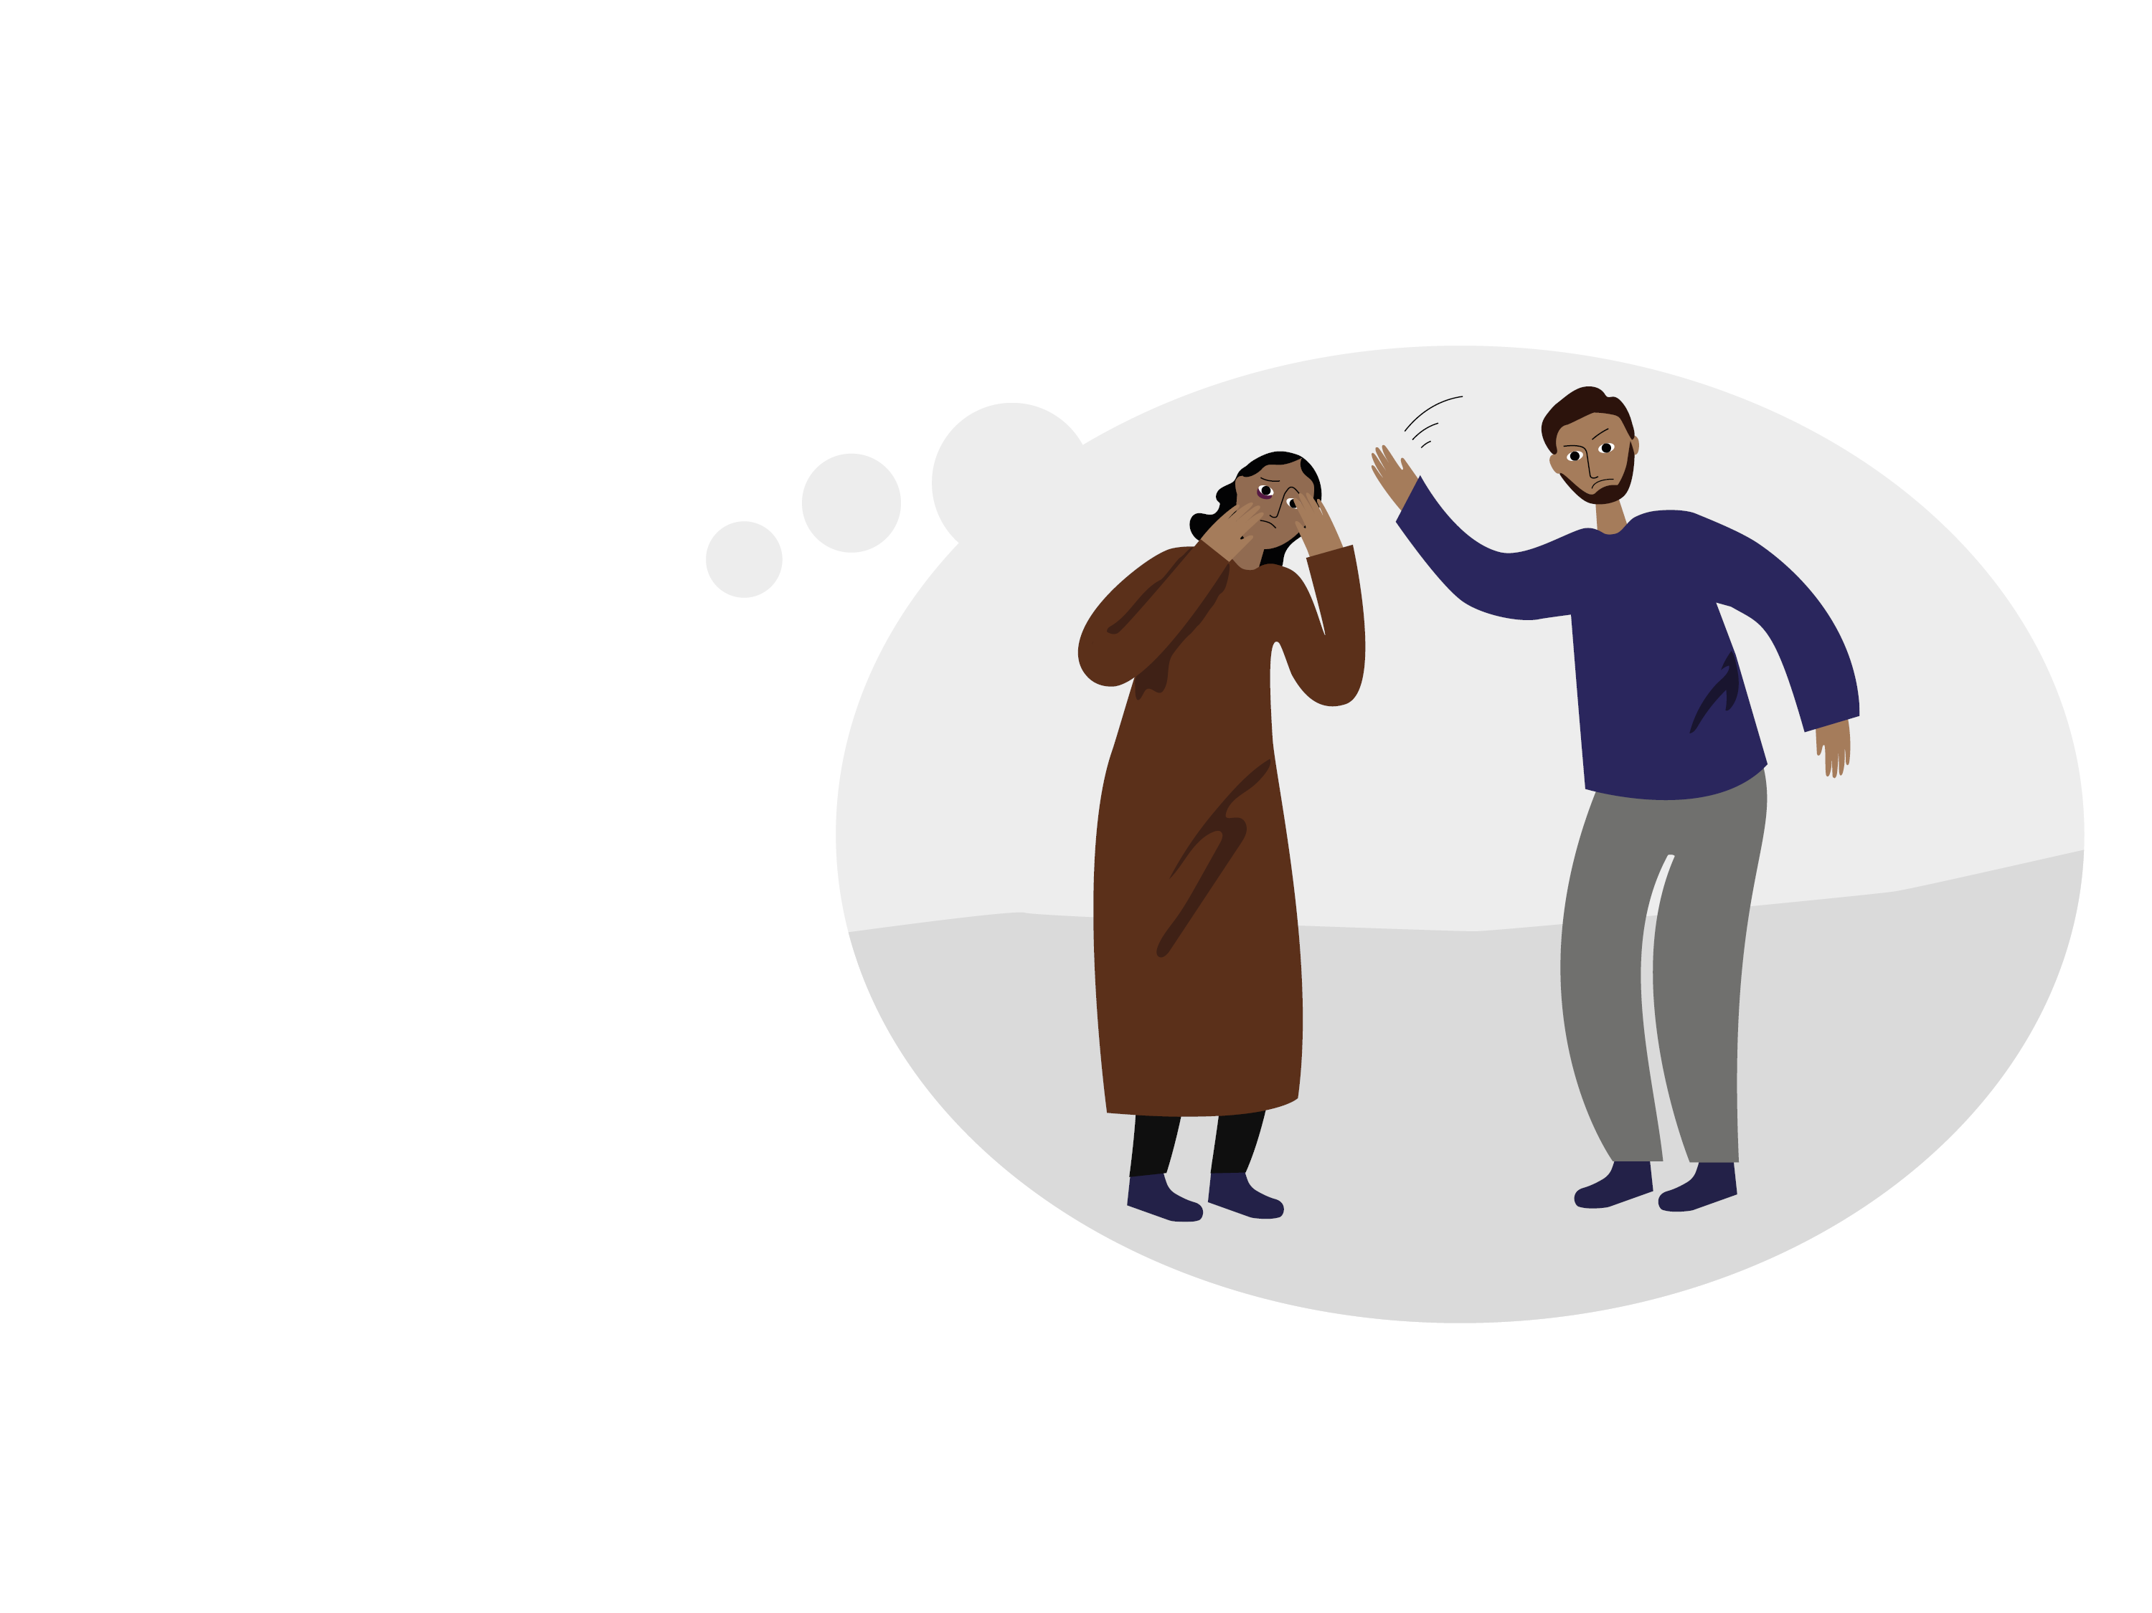
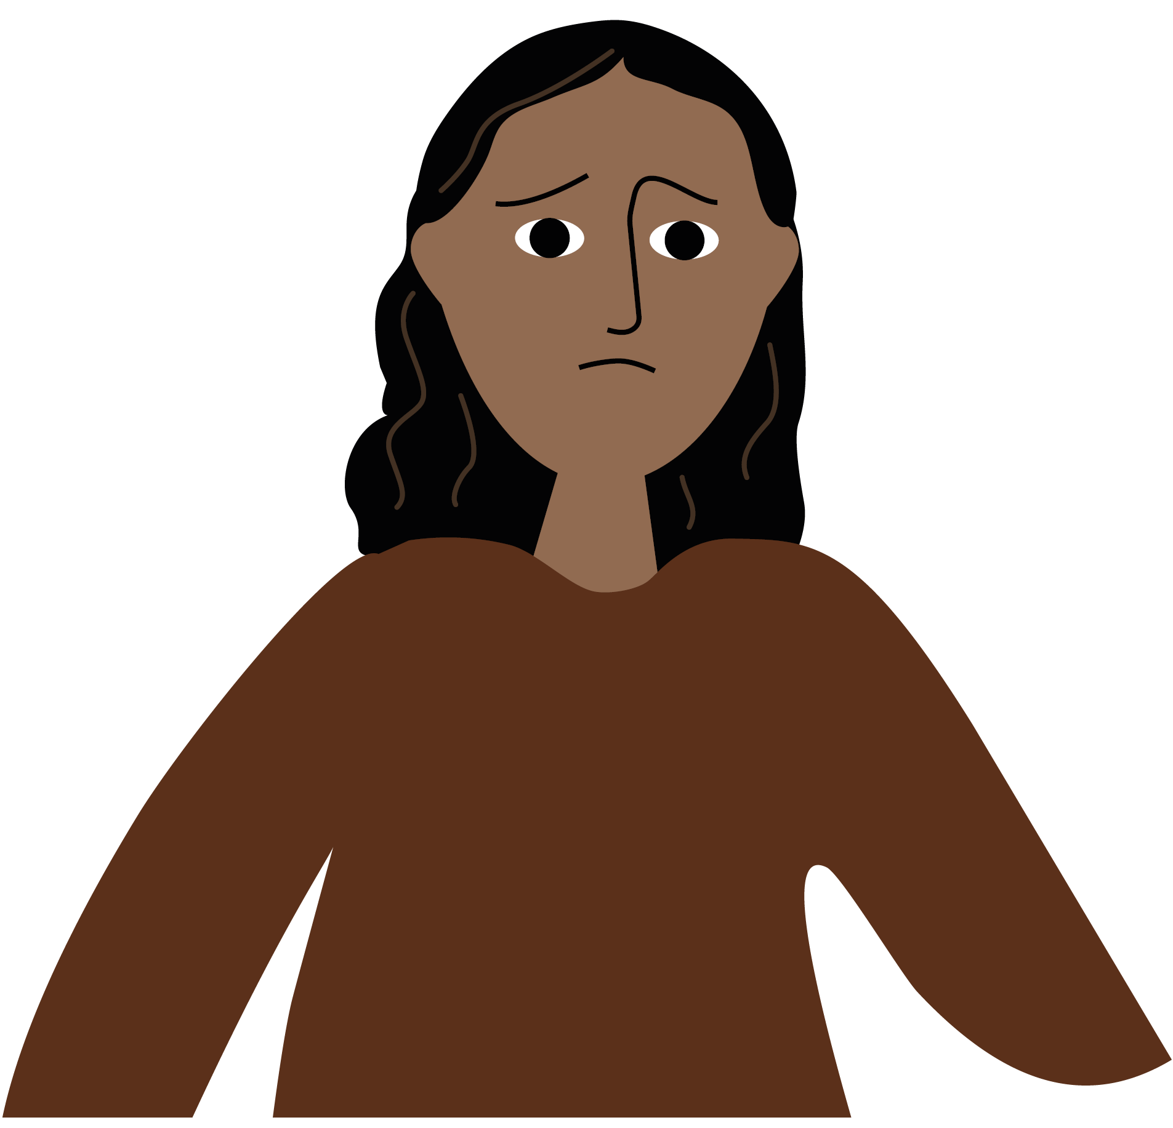
You may need international protection
if you cannot go back to your country
because you are threatened by other persons and the authorities of your country will not protect you.

Slide 6
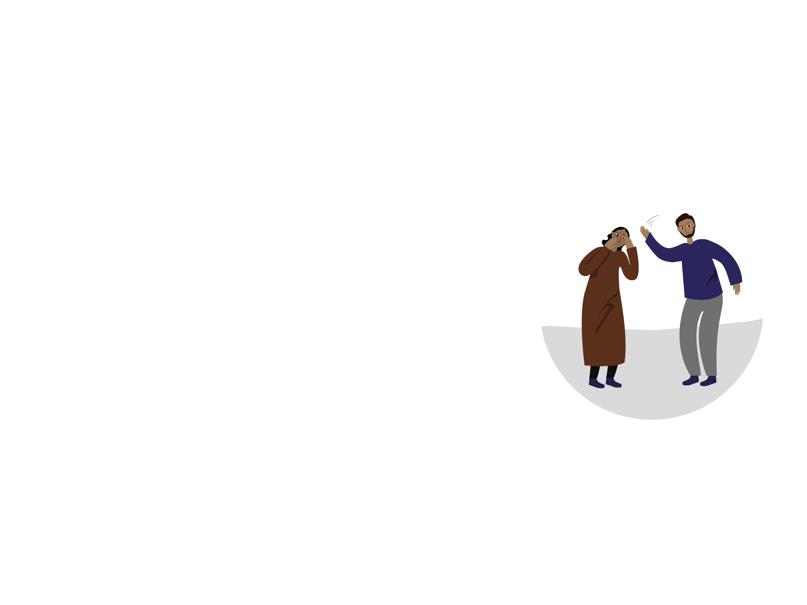
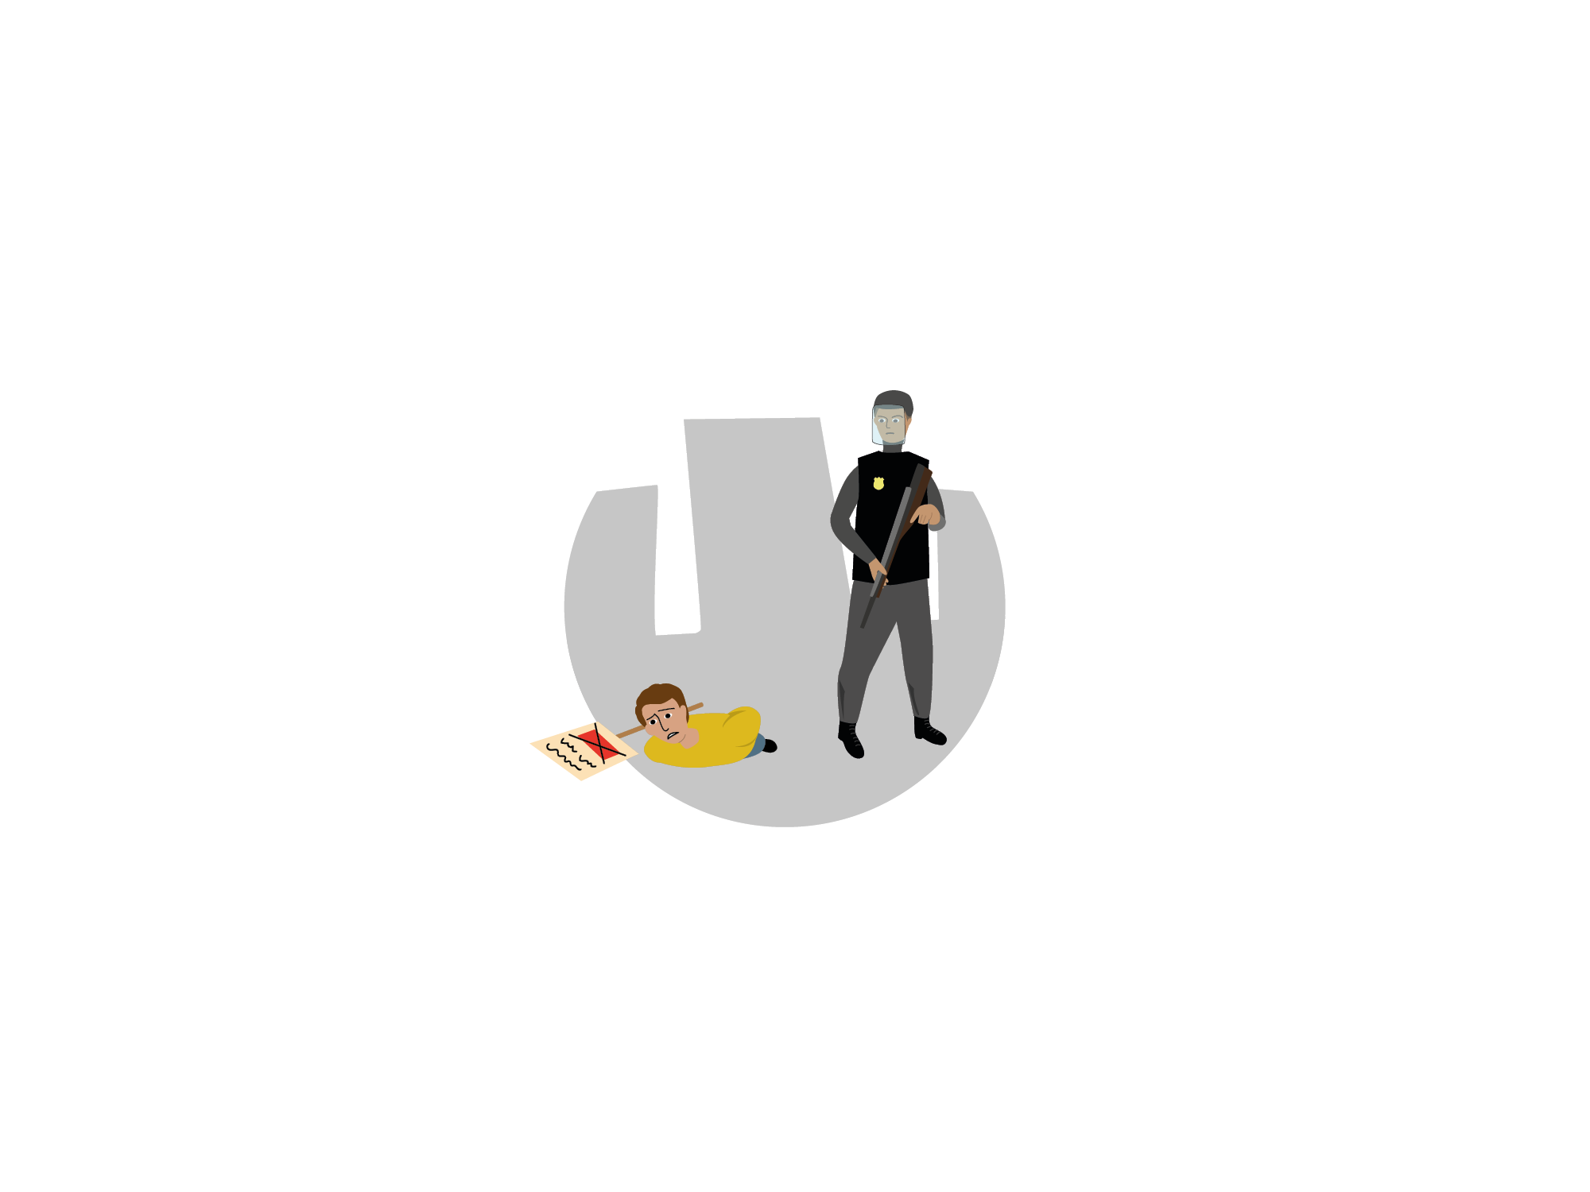
You may need international protection if you cannot go back to your country
because you are afraid for your life
OR
because your freedom will be threatened
OR
because you are threatened by other persons and the authorities of your country will not protect you

Slide 7
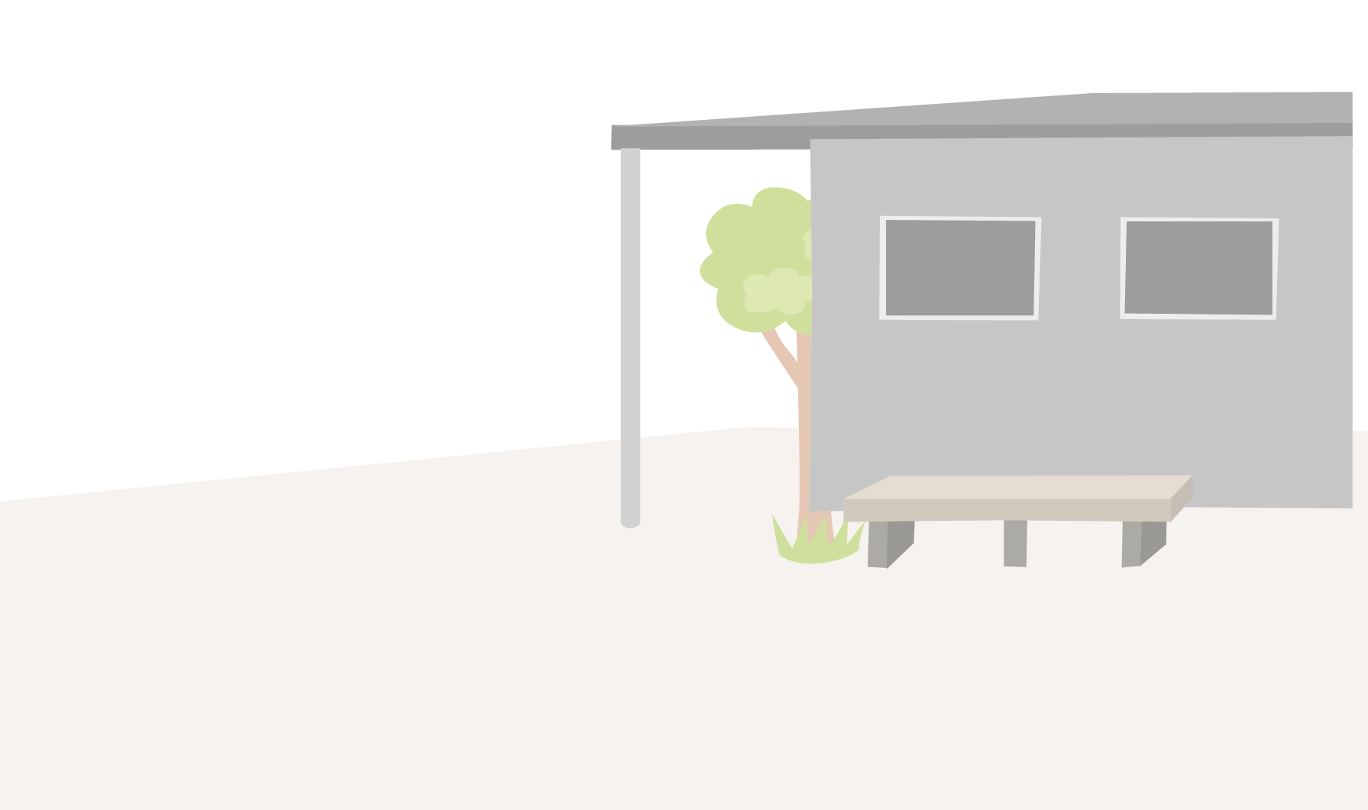
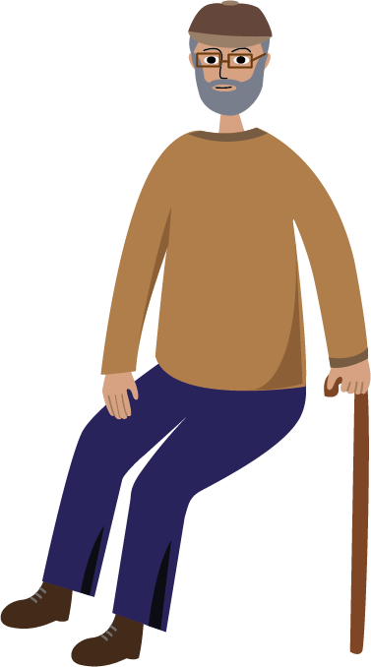
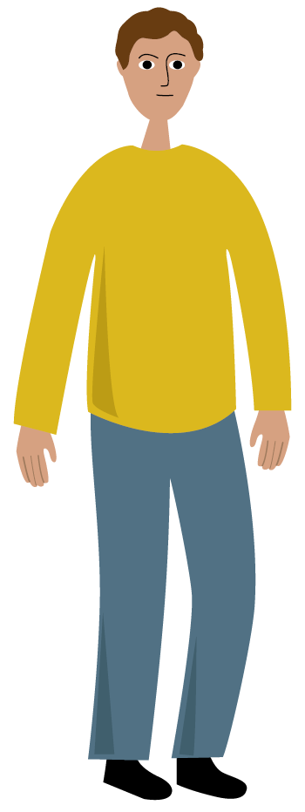
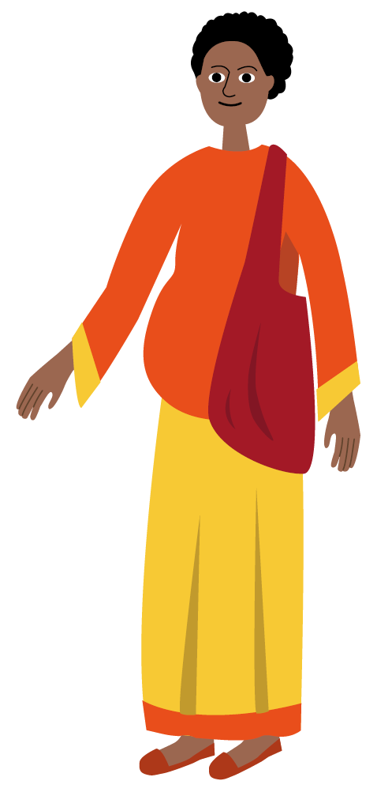
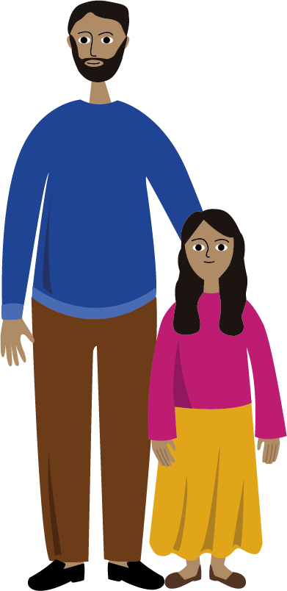
Applying for asylum gives you the right to stay until a final decision is made.

Slide 8
DO NOT PAY ANYONE FOR YOUR ASYLUM APPLICATION
Be cautious of people offering help in exchange for favours or money as they may take advantage of your situation.
Tell the authorities if somebody is forcing you to do something against your will.

Slide 9
The asylum application must be registered
REGISTRATION
Ask the national authorities how and where to register your application.

Slide 10
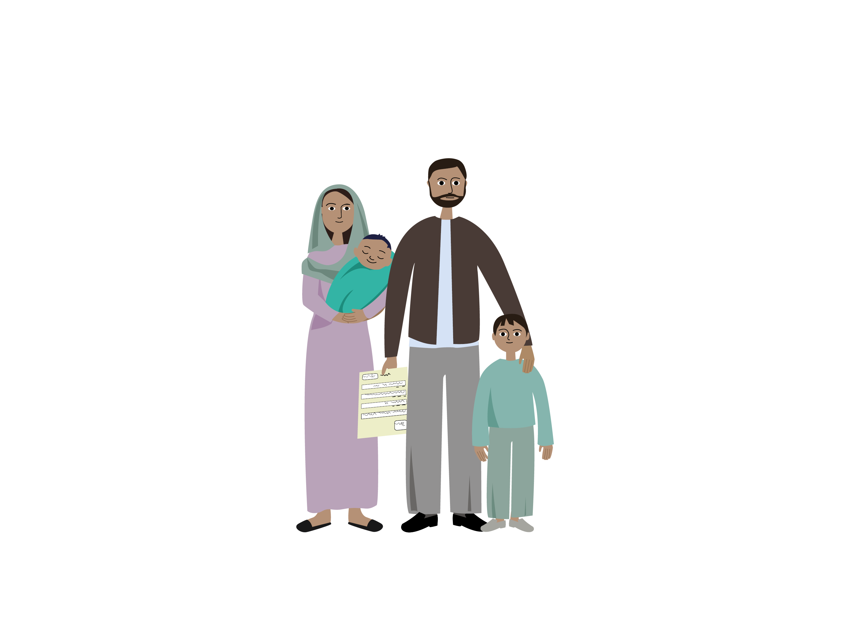
The asylum application must be registered
REGISTRATION
If you arrived with your family, ensure that all your family members are registered.

Slide 11
The asylum application must be registered
REGISTRATION
Registration ensures that you can remain in Europe and all your urgent needs will be addressed.

Slide 12
What will happen during registration

Slide 13
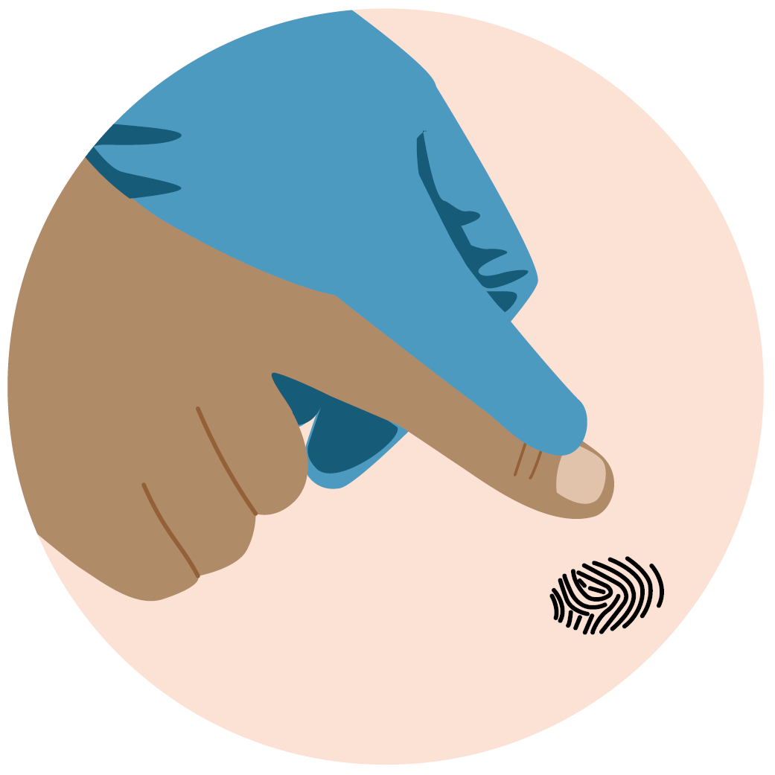
What will happen during registration
Your fingerprints will be taken.

Slide 14
What will happen during registration
Your fingerprints will be taken.
You will be photographed.

Slide 15
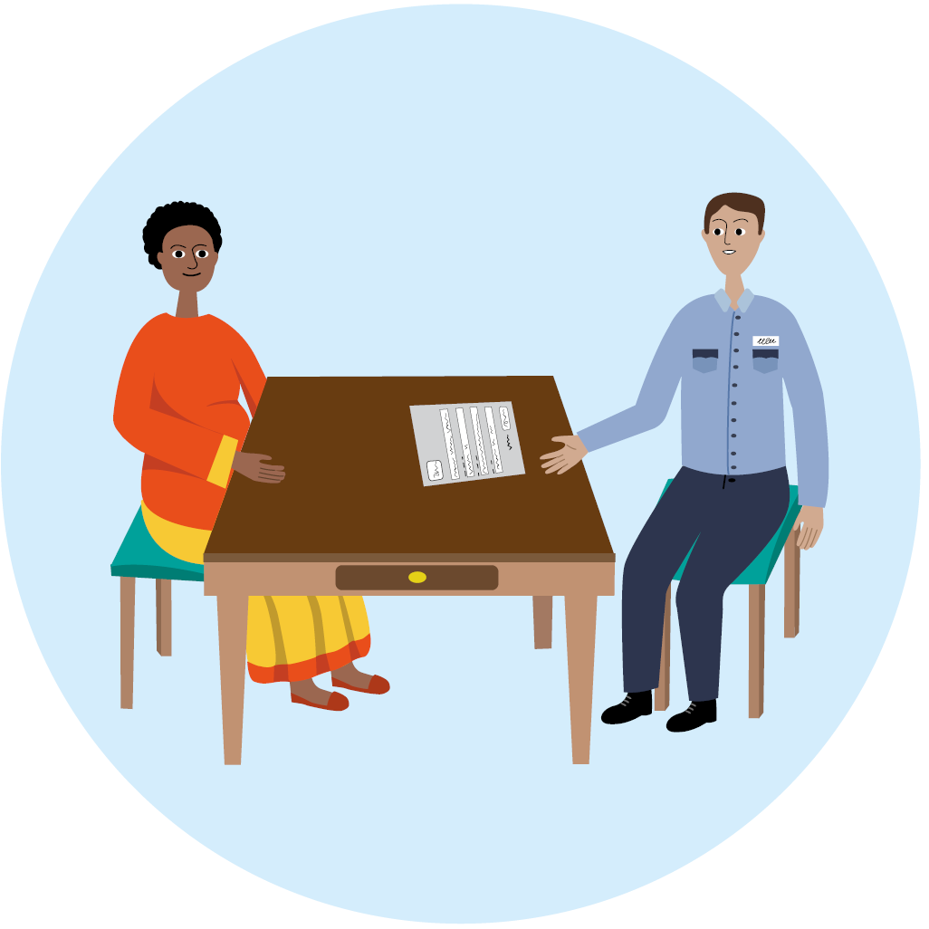
What will happen during registration
Your fingerprints will be taken.
You will be photographed.
An officer will ask about your name, your country, your date of birth and other details.

Slide 16
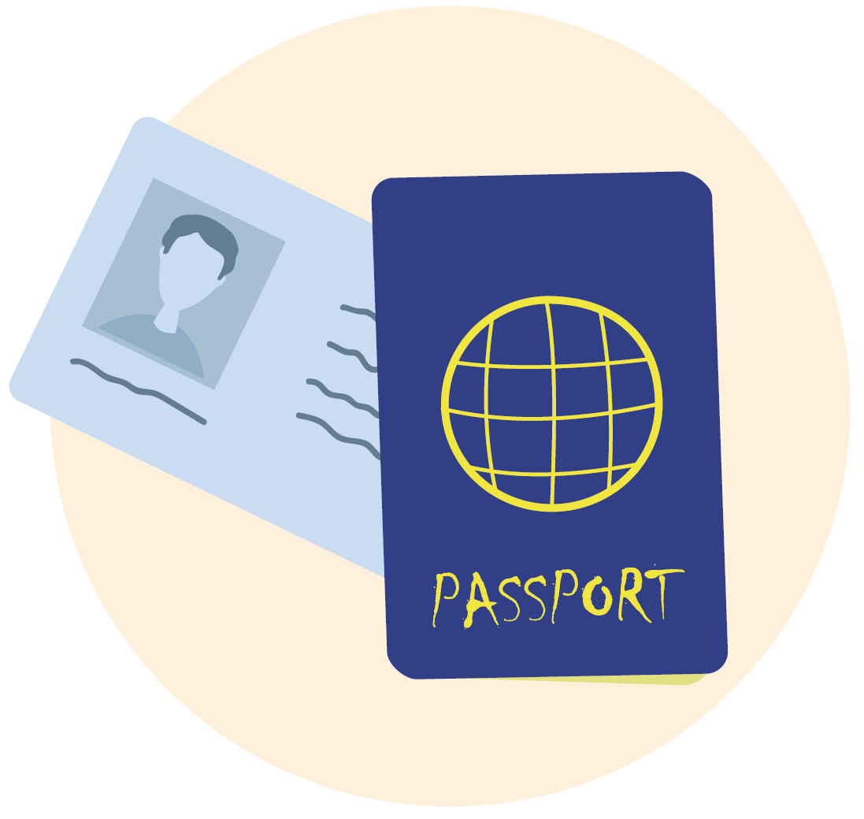
What will happen during registration
Your fingerprints will be taken.
You will be photographed.
An officer will ask about your personal details.
You must submit any identity documents that you have.

Slide 17
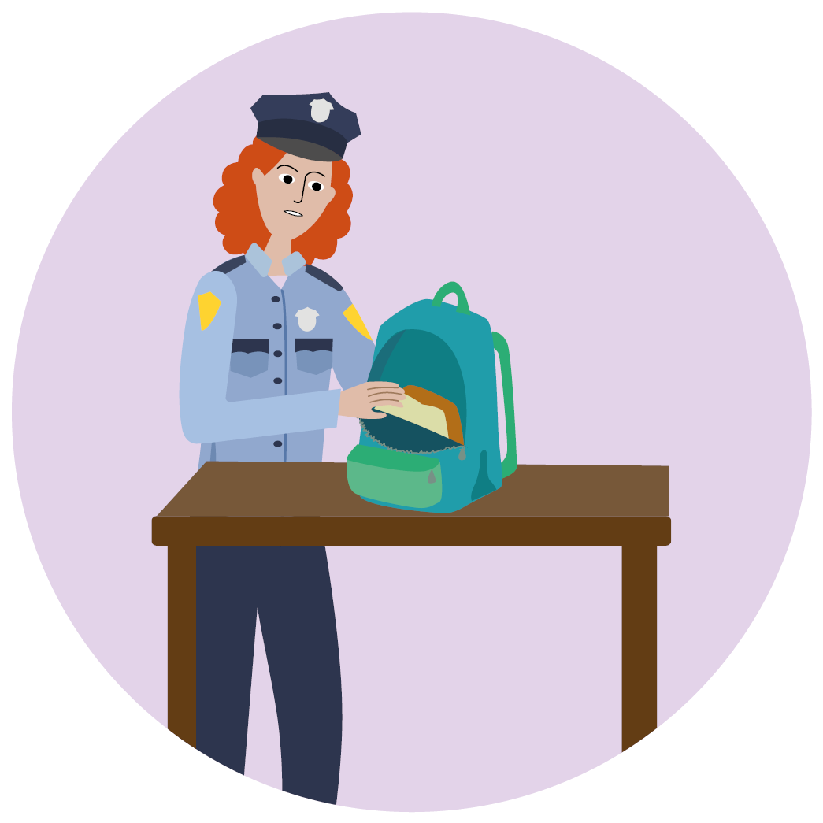
What will happen during registration
Your fingerprints will be taken.
You will be photographed.
An officer will ask about your personal details.
You must submit any identity documents that you have.
You and your belongings may be searched, but only for security reasons. Your personal things remain your property and will be given back to you.

Slide 18
What will happen during registration
Your fingerprints will be taken.
You will be photographed.
You and your belongings may be searched.
An officer will ask about your personal details.
You must submit any identity documents that you have.
You may see a doctor for a medical check.

Slide 19
What will happen during registration
Your fingerprints will be taken.
You will be photographed.
You and your belongings may be searched.
An officer will ask your personal details.
You may see
a doctor.
You must submit any identity documents that you have.
The order of these steps can differ, but all applicants are treated in the same way.
The registration will be finalised within hours or a few days. Ask the officials if you have any questions.

Slide 20
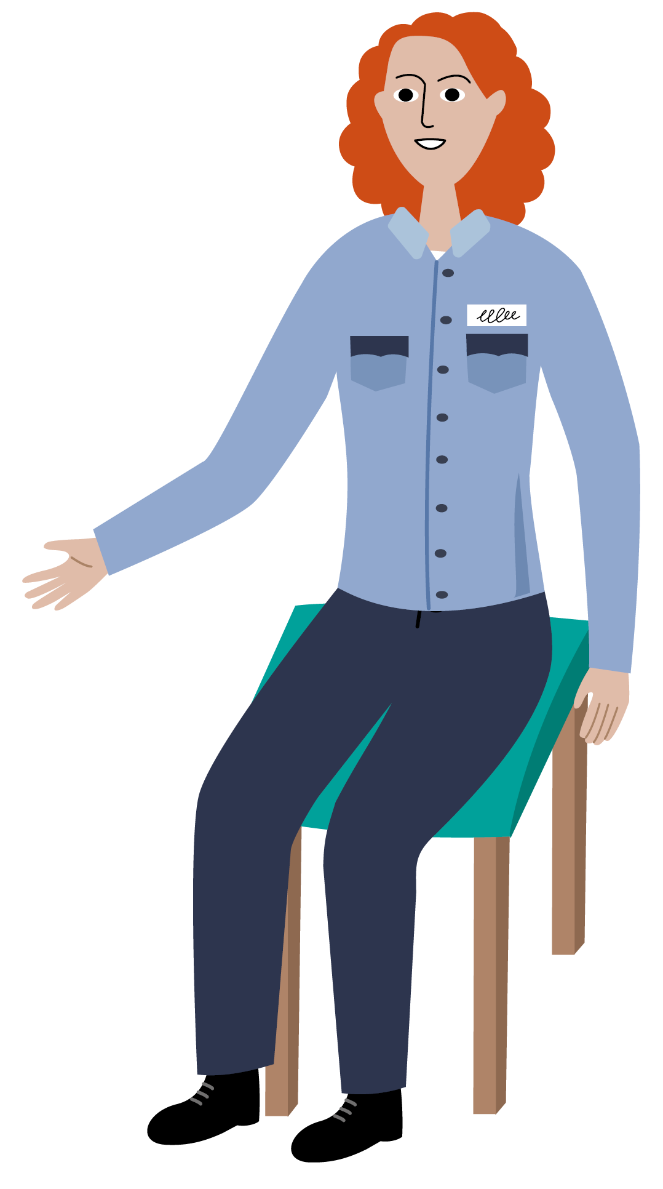
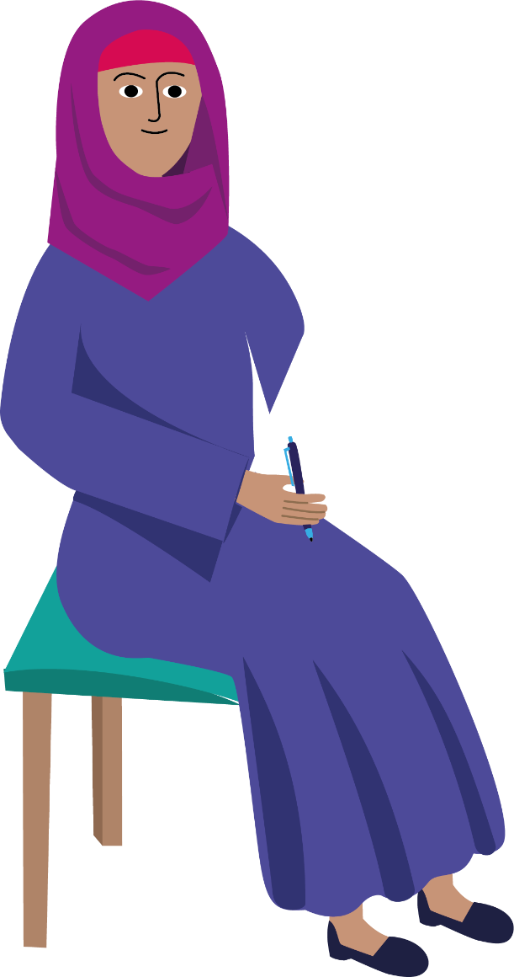
These procedures are standard for everyone.
It is your obligation and in your best interests to cooperate with the authorities and tell the truth.

Slide 21
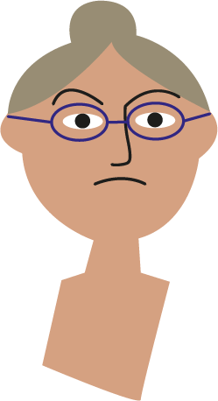
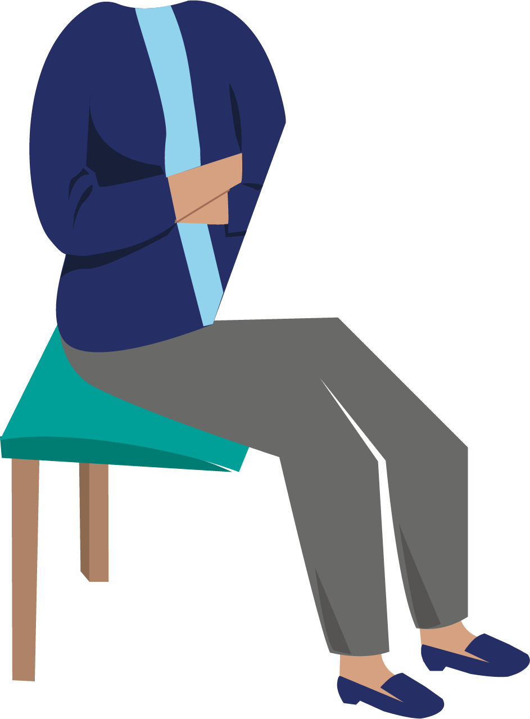
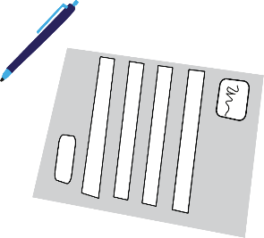
If you refuse to comply with these procedures, it may negatively affect your application.

Slide 22
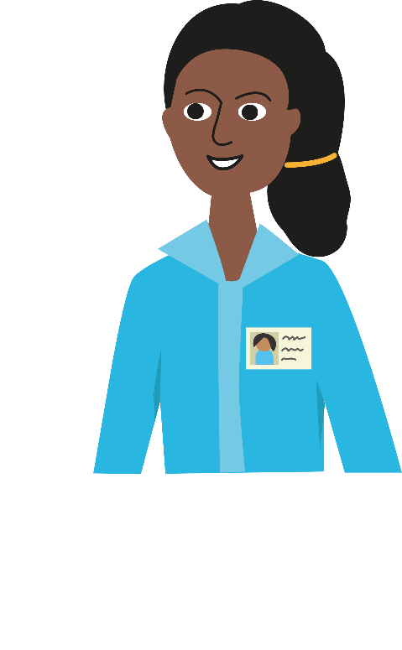
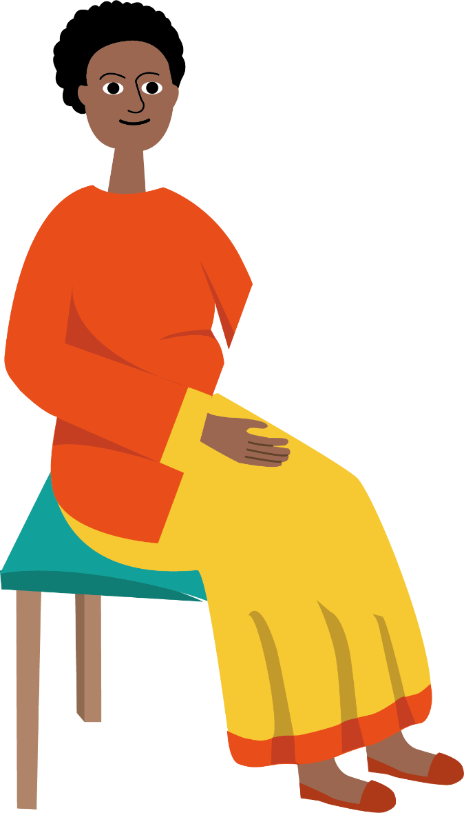
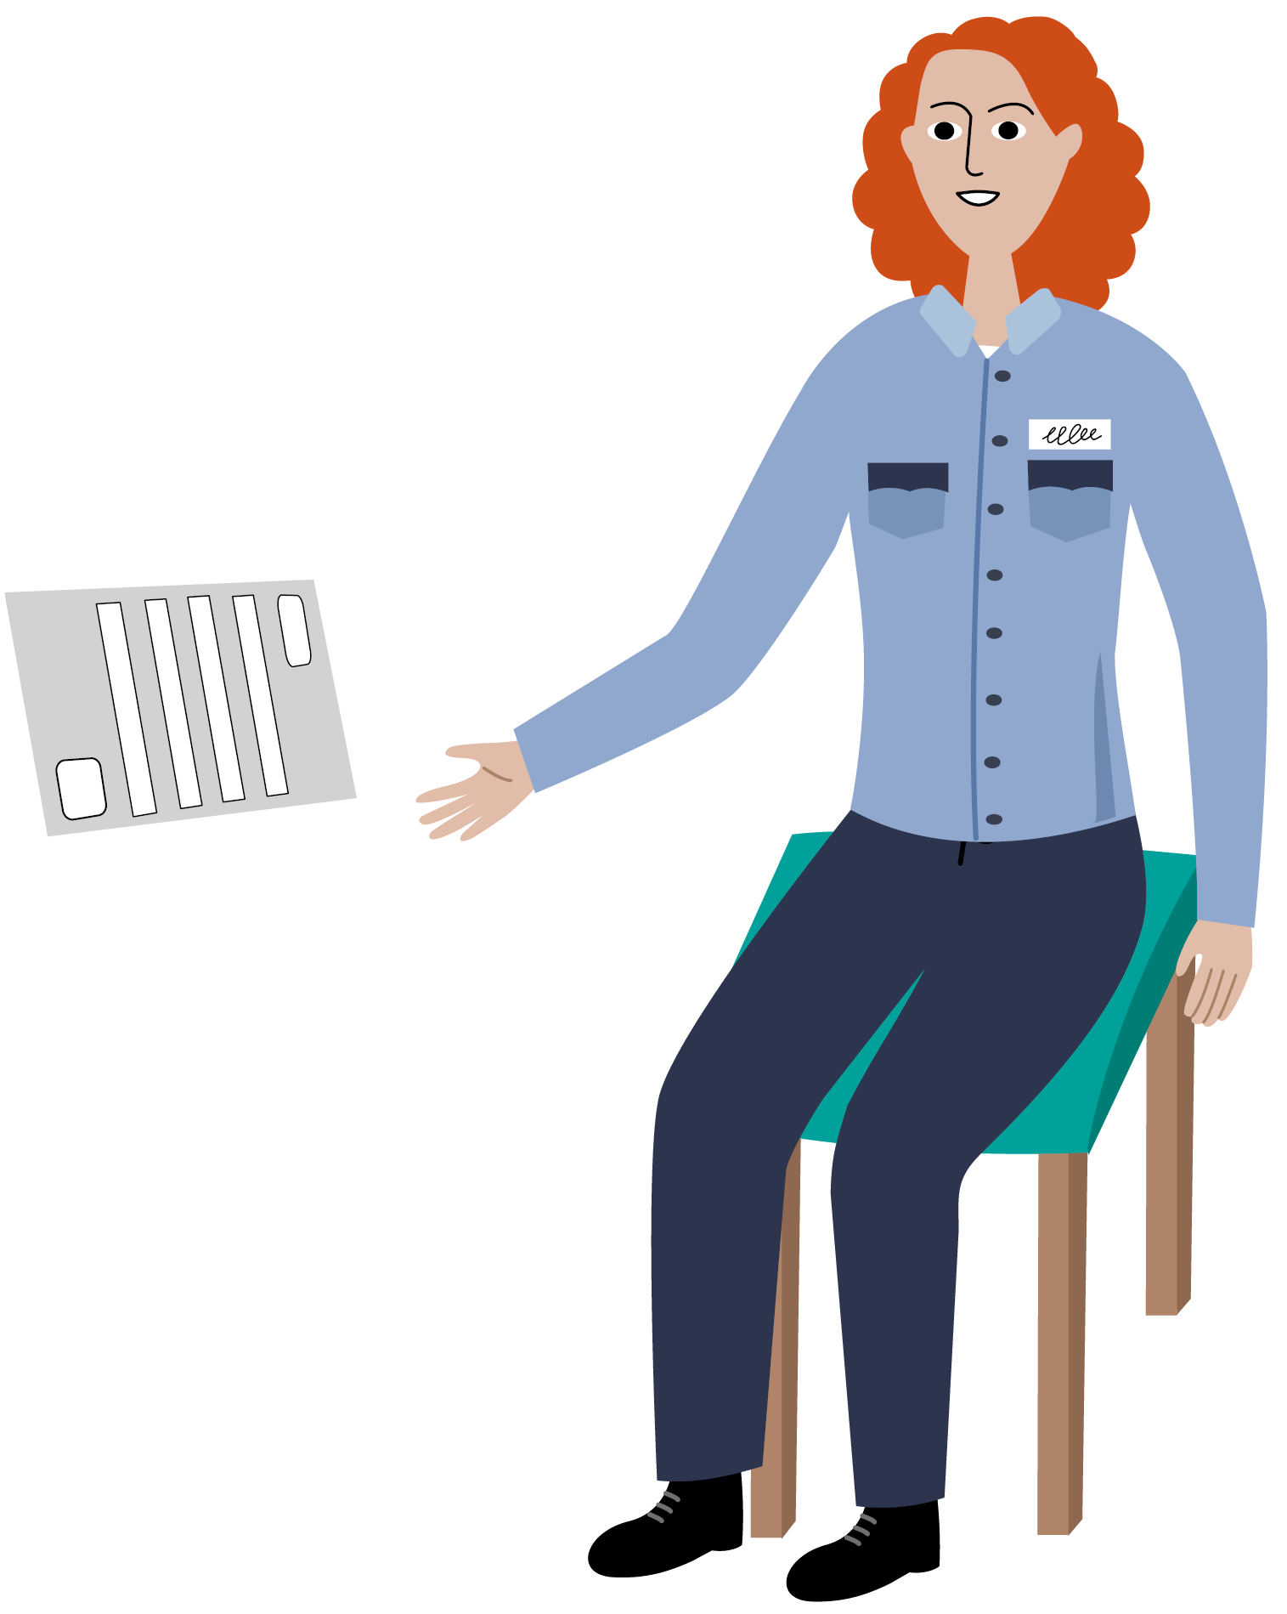
An interpreter will be available, if necessary.
It is important that you tell the authorities if you do not understand the official or the interpreter.

Slide 23
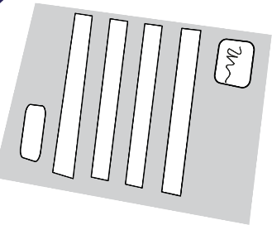
Any information you share with the authorities will stay confidential. It will not be shared outside the authorities without your consent. It will never be shared with the authorities in your home country.

Slide 24
In EUROPE, there are Rules regarding applying for asylum and travelling to other countries

Slide 25
In EUROPE, there are Rules regarding applying for asylum and travelling to other countries
As a general rule, you cannot choose the country in which you apply for asylum.

Slide 26
In EUROPE, there are Rules regarding applying for asylum and travelling to other countries
As a general rule, you cannot choose the country in which you apply for asylum.
You need to apply as soon as possible after you arrive in Europe.

Slide 27
In EUROPE, there are Rules regarding applying for asylum and travelling to other countries
As a general rule, you cannot choose the country in which you apply for asylum.
There is only one country responsible for the examination of your asylum application.
You should not move to another country on your own initiative. If you do so, you may be returned to the country that is responsible for your application.
You need to apply as soon as possible after you arrive in Europe.

Slide 28
In EUROPE, there are Rules regarding applying for asylum and travelling to other countries
As a general rule, you cannot choose the country in which you apply for asylum.
You need to apply as soon as possible after you arrive in Europe.
There is only one country responsible for the examination of your asylum application. You should not move to another country on your own initiative. If you do so, you may be returned back to the country that is responsible for your application.

Slide 29
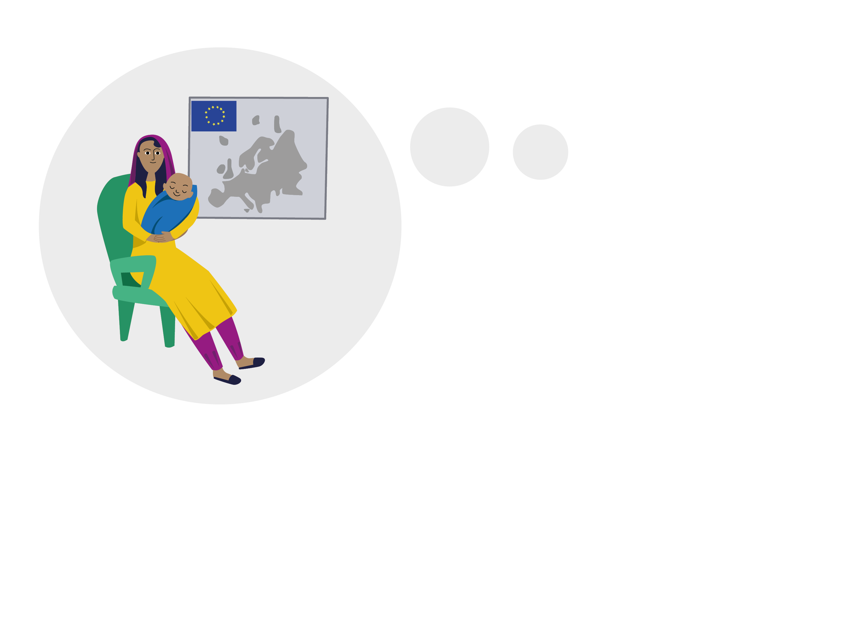
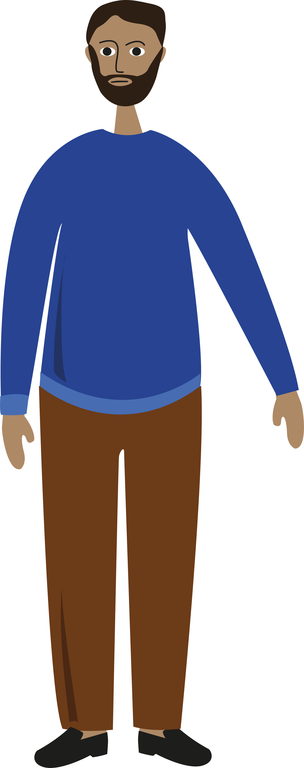
If you have family members in Europe, let the officials know. You will receive further explanations regarding the rules for family reunification.

Slide 30
The asylum procedure can last several months
After a certain time, you may have the right to work. Ask the authorities for more information.

Slide 31
Depending on your situation, you will receive:

Slide 32
Depending on your situation, you will receive:
a place to sleep

Slide 33
Depending on your situation, you will receive:
a place to sleep
food

Slide 34
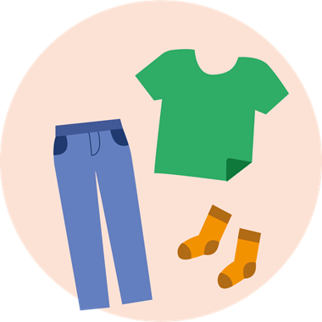
Depending on your situation, you will receive:
a place to sleep
food
clothes

Slide 35
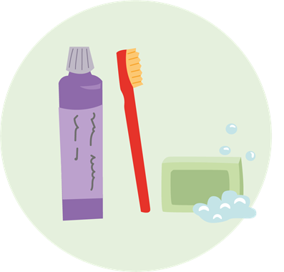
Depending on your situation, you will receive:
a place to sleep
food
clothes
hygiene products

Slide 36
Depending on your situation, you will receive:
hygiene products
a place to sleep
food
clothes
and medical assistance

Slide 37
Depending on your situation, you will receive:
hygiene products
a place to sleep
medical assistance
food
clothes
You will receive more information about what type of support will be provided.

Slide 38
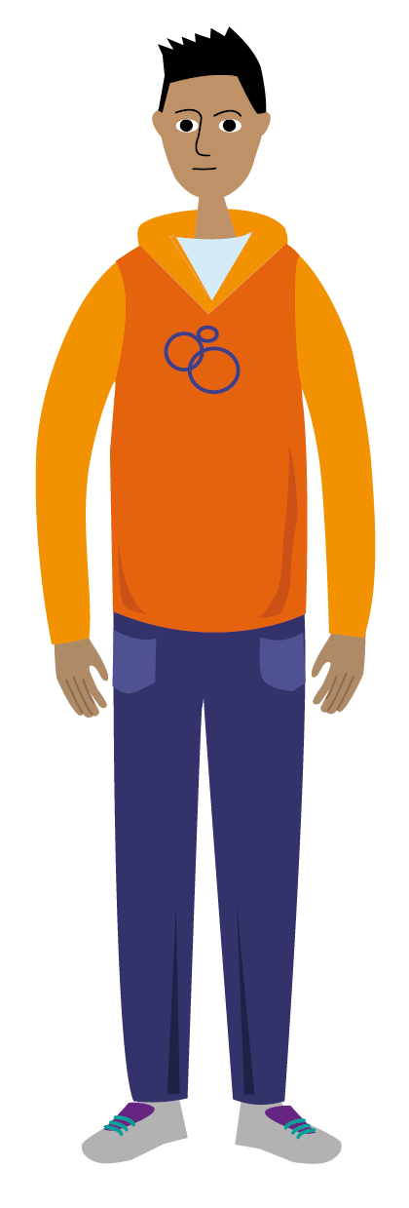
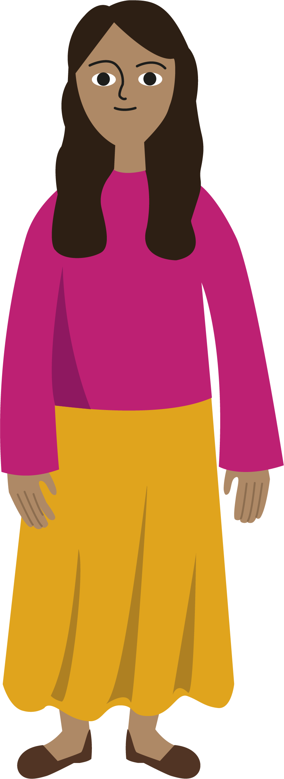
In Europe, everyone under the age of 18 is considered to be a child.
If you are younger than 18, please tell an official so you can get help.

Slide 39
Also let the Authorities know if:

Slide 40
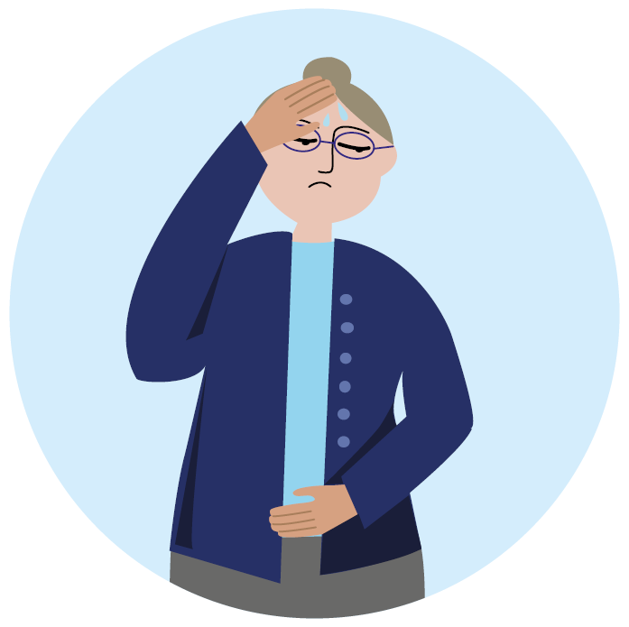
Also let the Authorities know if:
You do not feel well, you are injured or need urgent medical assistance.

Slide 41
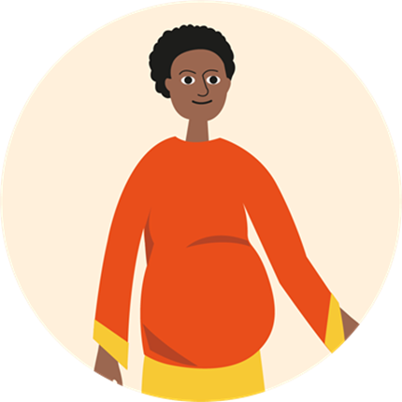
You do not feel well, you are injured or need urgent medical assistance.
Also let the Authorities know if:
You are pregnant.

Slide 42
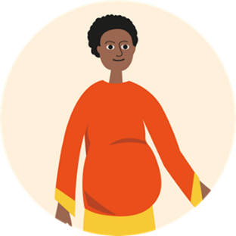
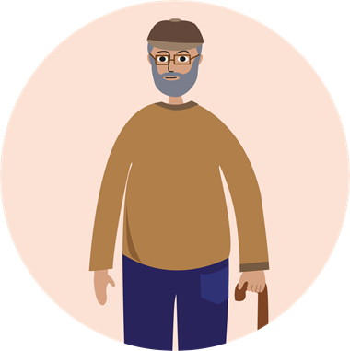
You do not feel well, you are injured or need urgent medical assistance.
Also let the Authorities know if:
You are pregnant.
You have a disability or other health issue.

Slide 43
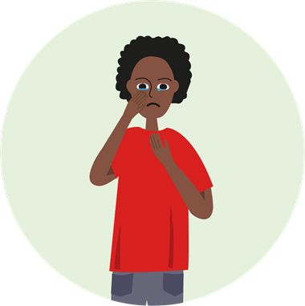
You do not feel well, you are injured or need urgent medical assistance.
Also let the Authorities know if:
You are pregnant.
You have a disability or other health issue.
You don’t currently feel safe.

Slide 44
You do not feel well, you are injured or need urgent medical assistance.
Also let the Authorities know if:
You are pregnant.
You have a disability or other health issue.
You don’t currently feel safe.

Slide 45
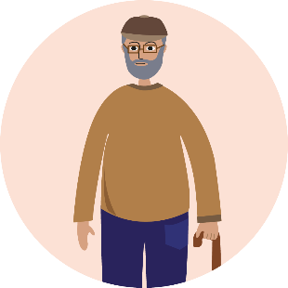
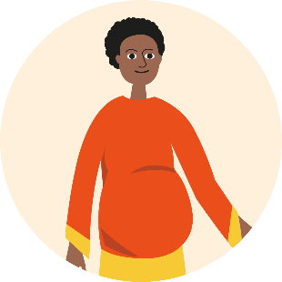
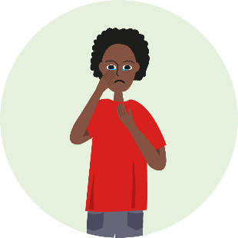
Also let the Authorities know if:
You do not feel well,
you are injured or need urgent medical assistance.
You have a disability or other health issue.
You don’t currently feel safe.
You are pregnant.

Slide 46
THANK YOU

Slide 47
Neither the European Union Agency for Asylum (EUAA) nor any person acting on behalf of the EUAA shall be liable for the use that might be made of this product nor shall they be liable for any consequence stemming from its use.
The EUAA does not accept any responsibility or liability for the accuracy, content, completeness, legality, or reliability of the information added to the original content of this product by the national authorities or by any other responsible third party.

